Slide 1


Block Release
Dr Nazmul hussain

Slide 2

Attendance Afternoon Session

Slide 3
Session Objectives
Database Normalisation Presentation (15 min)
Design your database from Car_tyres_dataset (30 min)
Connecting to Azure Labs and Creating and Querying Database (1:30 min)

Slide 4
Normalisation
Normalization is a systematic approach of decomposing tables to eliminate data redundancy(repetition) and undesirable characteristics like Insertion, Update and Deletion Anomalies.
Normalization is used for mainly,
Eliminating redundant(useless) data.
Ensuring data dependencies make sense i.e. data is logically stored.
Ensuring the accuracy and integrity of the data.

Slide 5
Normalization Rule
Normalization rules are divided into the following normal forms:
First Normal Form - Remove composite attribute and multivalued attribute and there must be primary key.
Second Normal Form - Remove partial Key Dependencies.
Third Normal Form - Remove non key dependencies.
Boyce-Codd Normal Form (BCNF) - It is an extension of 3NF.
Fourth Normal Form

Slide 6
Unnormalized Data (0 NF)
Name | JOB_CODE | JOB | STATE_CODE | HOME_STATE
Alice | J01,J02 | Chief, Waiter | 26 | Michigan
Bob | J02, J03 | Bartender, Waiter | 56 | Wyoming

Slide 7
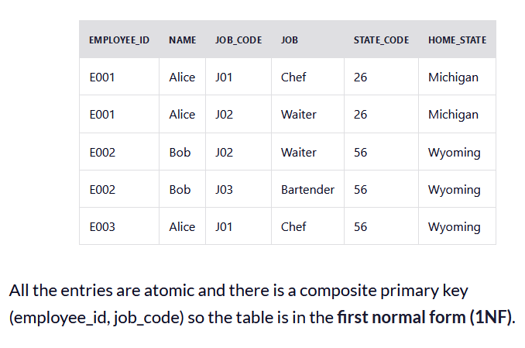
1. First Normal Form (1NF)
a single cell must not hold more than one value (atomicity).
there must be a primary key for identification.
no duplicated rows or columns.
each column must have only one value for each row in the table.

Slide 8
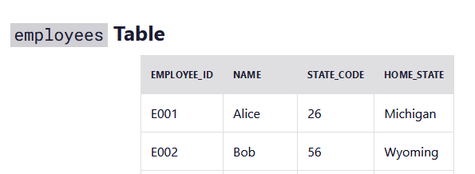
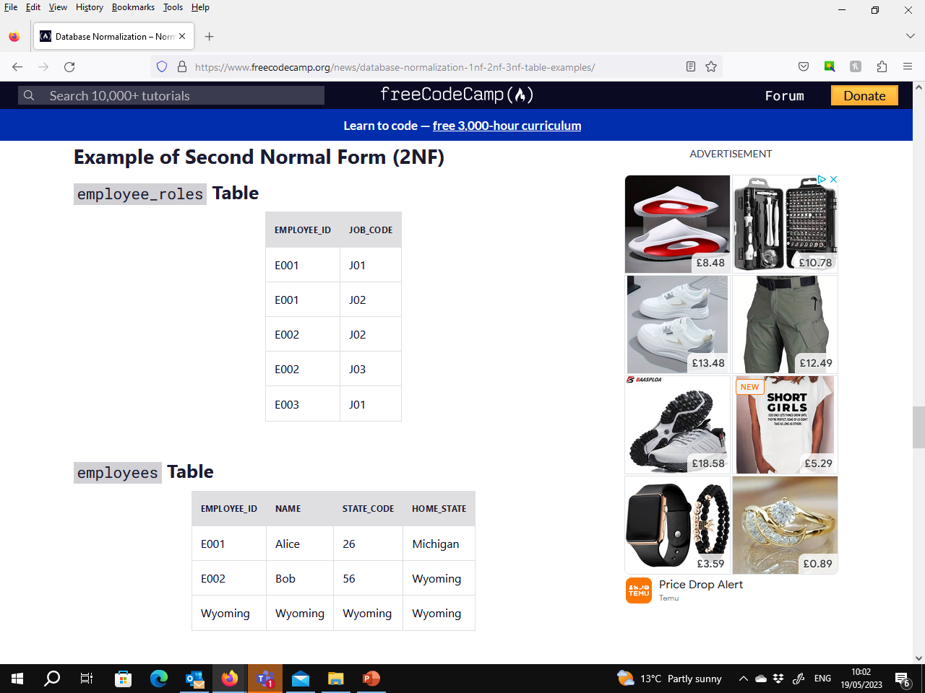
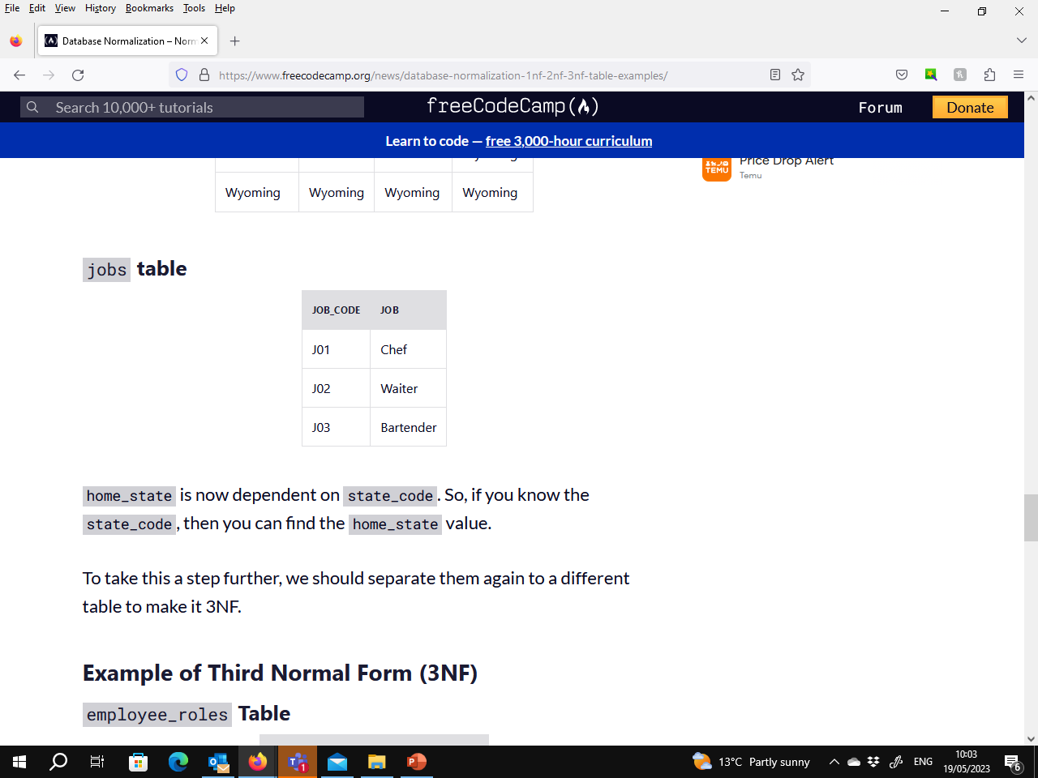
2. Second Normal Form (2 NF)
it’s already in 1NF.
has no partial dependency. That is, all non-key attributes are fully dependent on a primary key.
Create separate tables for sets of values that apply to multiple records.
Relate the tables with a foreign key.

Slide 9
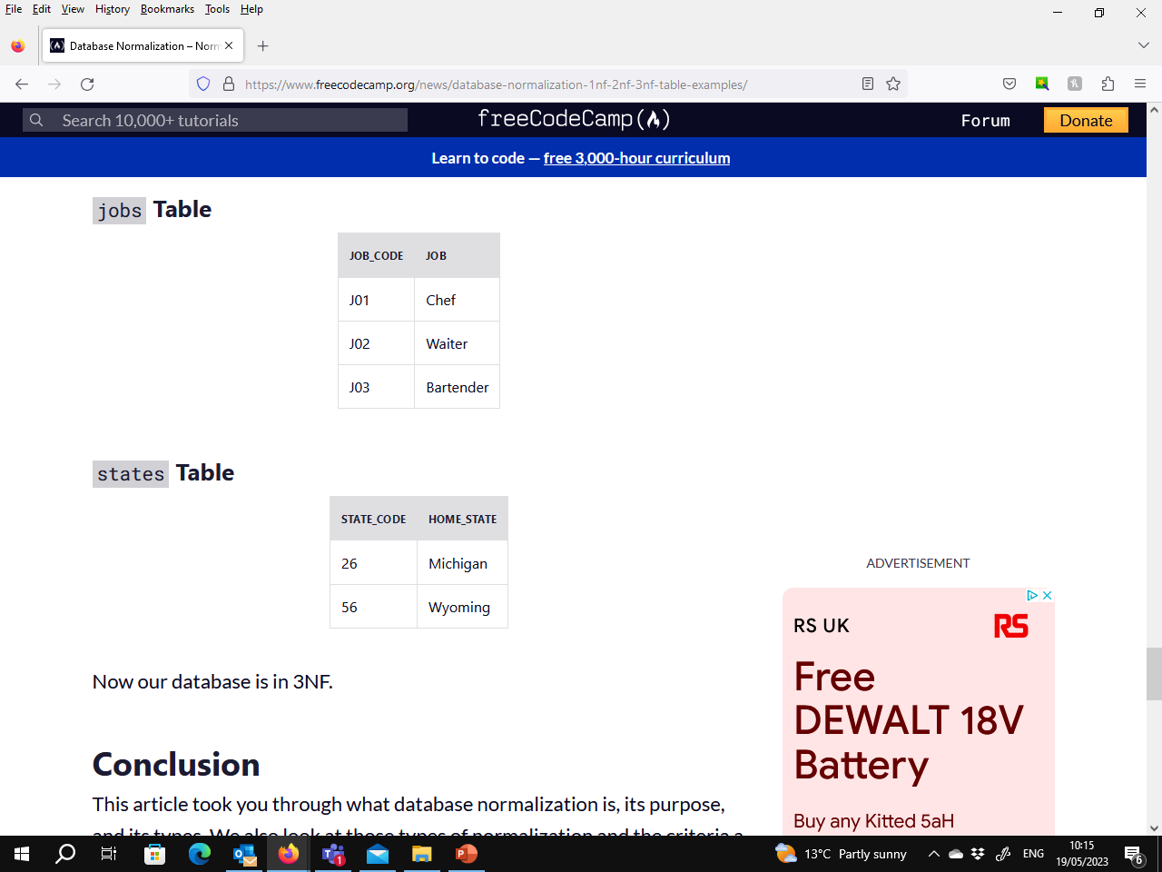
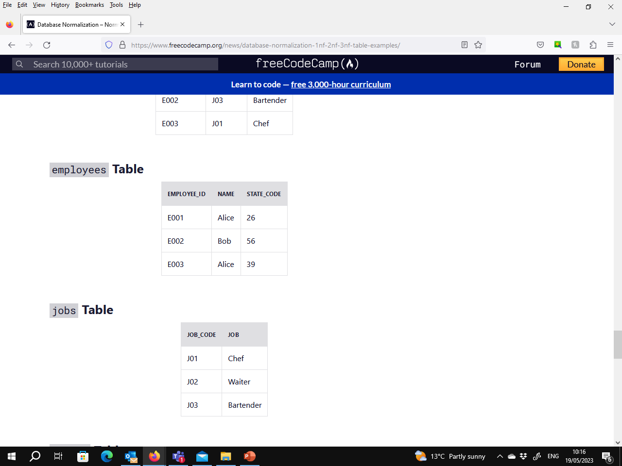
3. Third Normal Form (3 NF)
have no transitive partial dependency.
Eliminate fields that do not depend on the primary key.
Each non-primary key attribute must be dependent only on primary key.

Slide 10
Final Table Relations

Slide 11
https://github.com/UoN-CS/dsda-comp1-data-lab

